Slide 1

EARLY WARNING SYSTEM

Slide 2





TECH WARRIORS
Akhilesh Akula
Nachammai Palaniappan
Komali Reddy
Sreelekha Budigi
Ram Kiran Godavarthi

Slide 3
PROBLEM STATEMENT
Develop an early-warning system for small businesses which are at risk of closure using current and historic economic data.
Target : Business Owners & Bank Loan Officers

Slide 4
YELP Restaurant Information
Dollars
Photos
COVID Measures
DOHMH
NYC Restaurant Inspection Results
Zipcode
Grade
Date
DATA
YELP Restaurant Reviews
Review
Review Date
Restaurant Name
Revenue
Attributes
Sentiment Analysis

Slide 5
TOOLS : Python
Connecting to Database
Web Scrapping
Zipcode Plotting
psycopg2
sqlalchemy
selenium
bs4
webdriver_manager.chrome
requests
geopandas
shapely
folium
Sentiment Analysis
Clustering
Modelling
vaderSentiment
Natural Language Tool Kit (NLTK)
kprototypes
plotly
keras
lightgbm
xml.etree.ElementTree
sklearn
statsmodels.api
Pmdarima
keras
LSTM

Slide 6
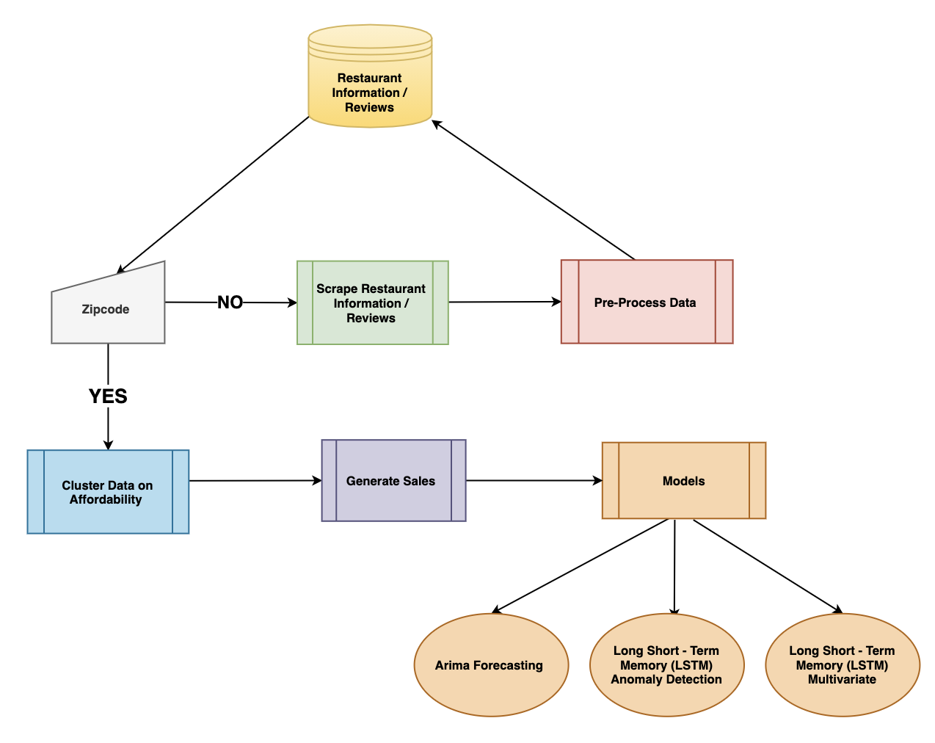
OVERVIEW OF THE PRODUCT

Slide 7
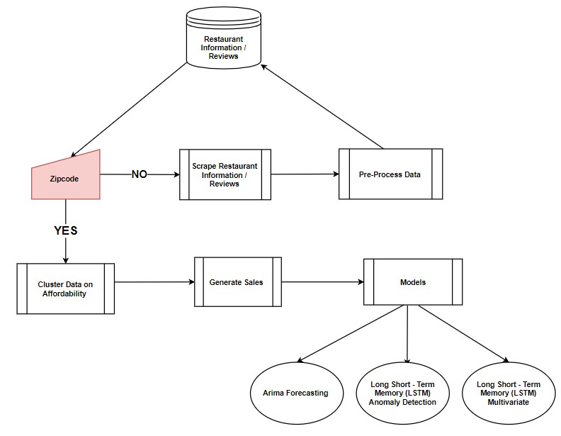
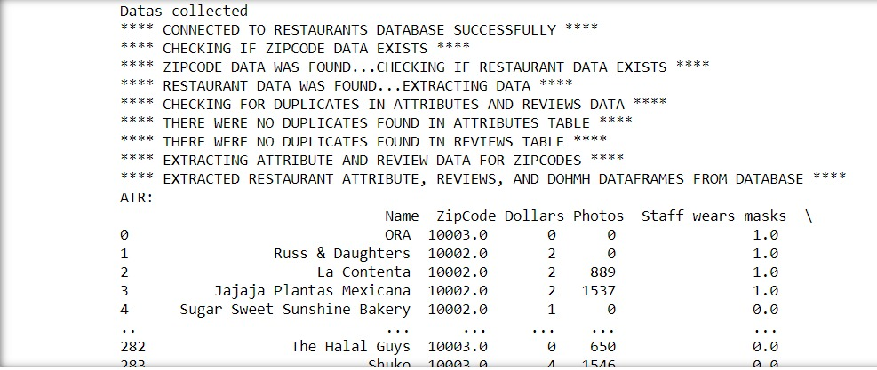

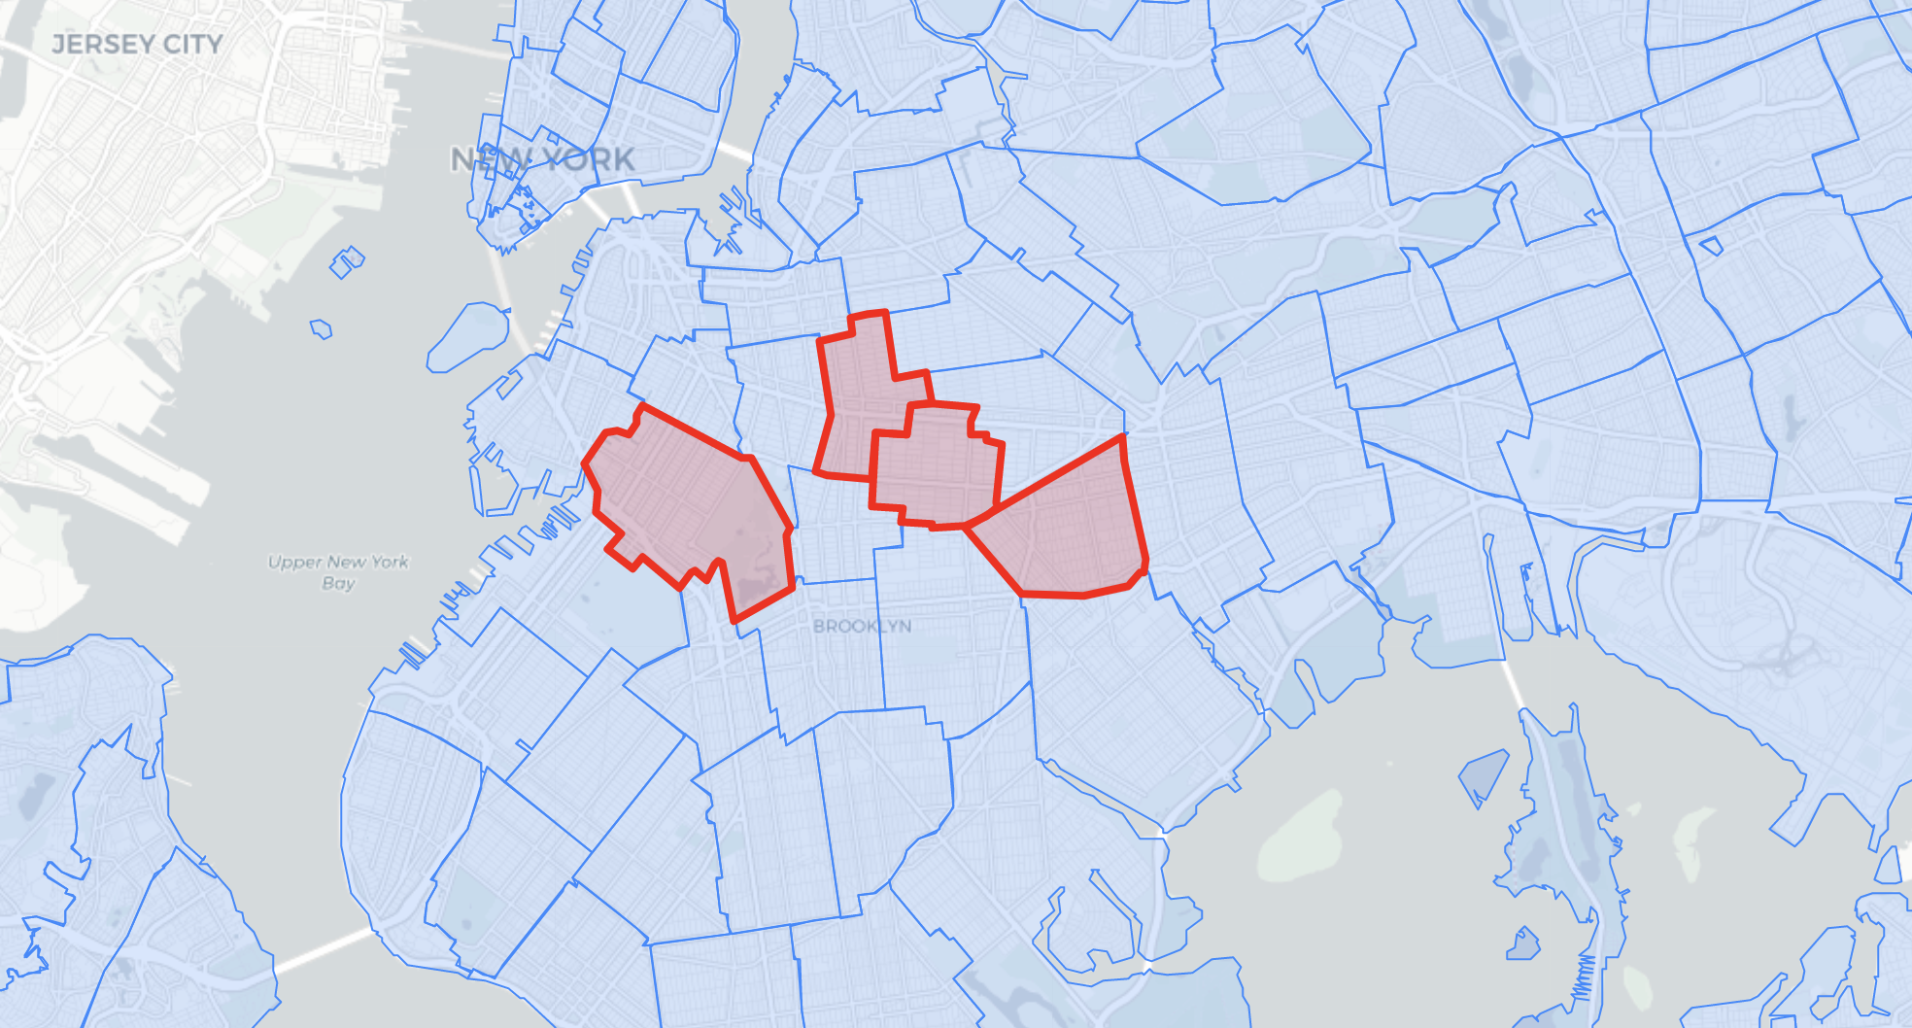
STEP 1: User Input
11213
11215
11212
11216
The user will be prompted to enter a zip code, currently one from New York.

Slide 8
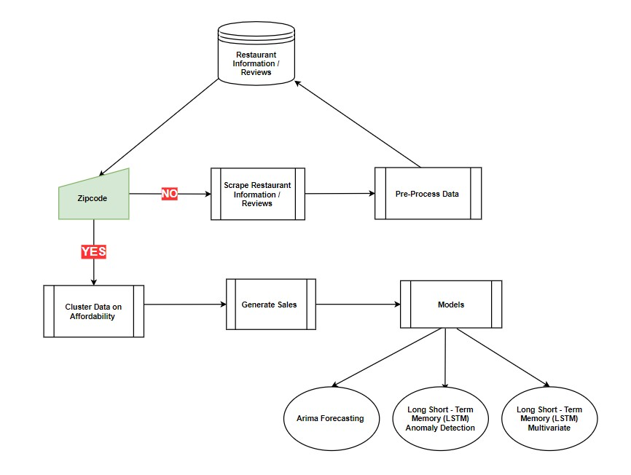
Zip code Exists in Database
Cluster Data Affordability
NO
YES
Scrape Data From Yelp
Pre-Process Data
Send Data to Database
STEP 2:Data Retrieval

Slide 9
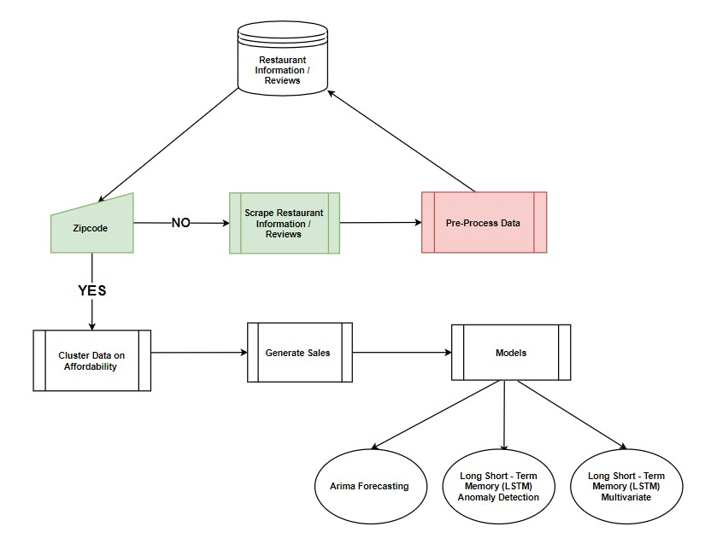
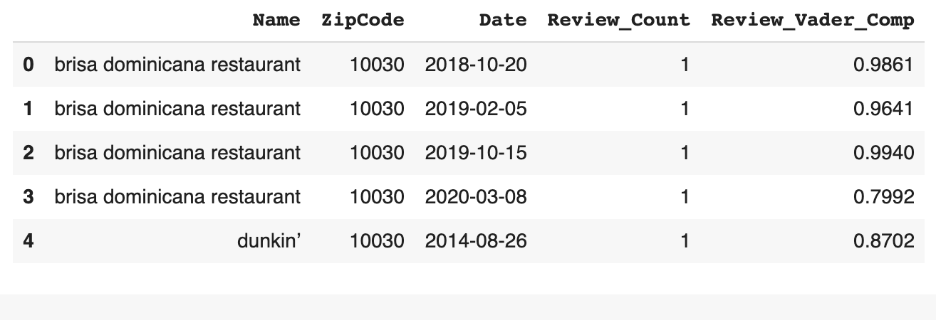
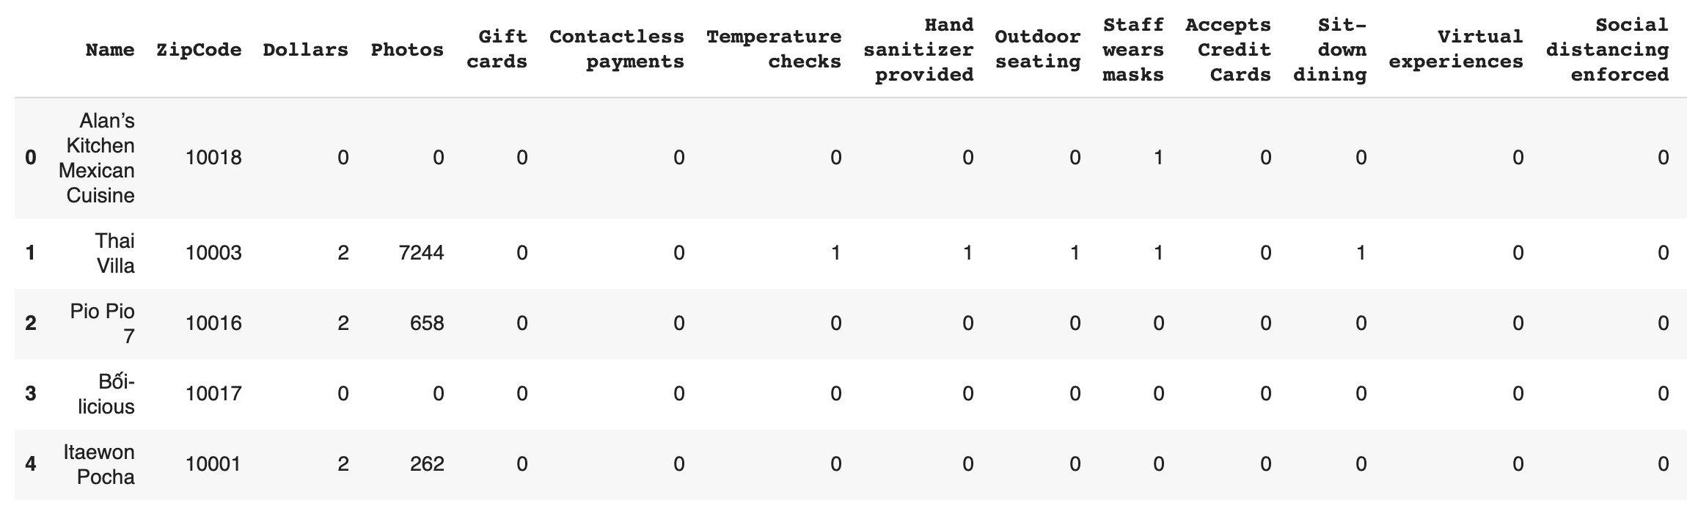
STEP 3 : Pre-Process Data
Reviews
Attributes
The acquired data is cleaned, making sure that only the necessary columns are being used and to ensure that all the data we need is being formatted in a proper way. This is essential in order to cluster the data

Slide 10
DATABASE LAYOUT
Restaurant
Database
Yelp
Schema
Zipcode
Table
Attributes
Table
Reviews
Table
DOHMH
Table

Slide 11
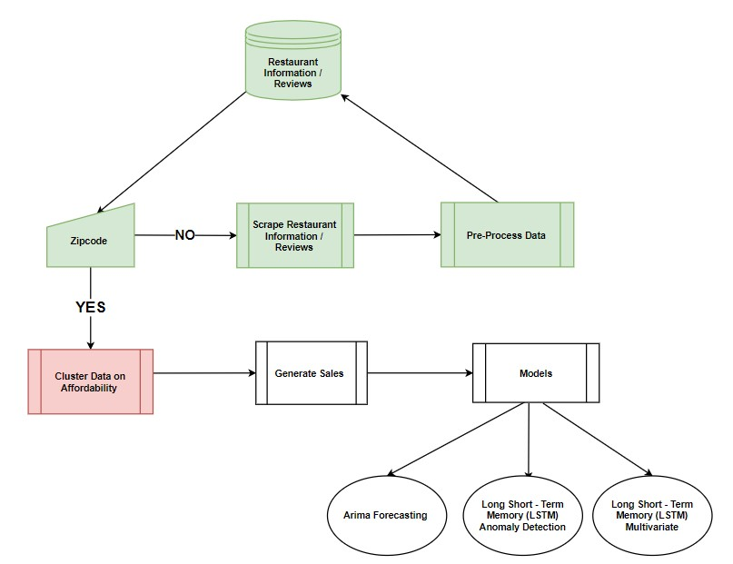
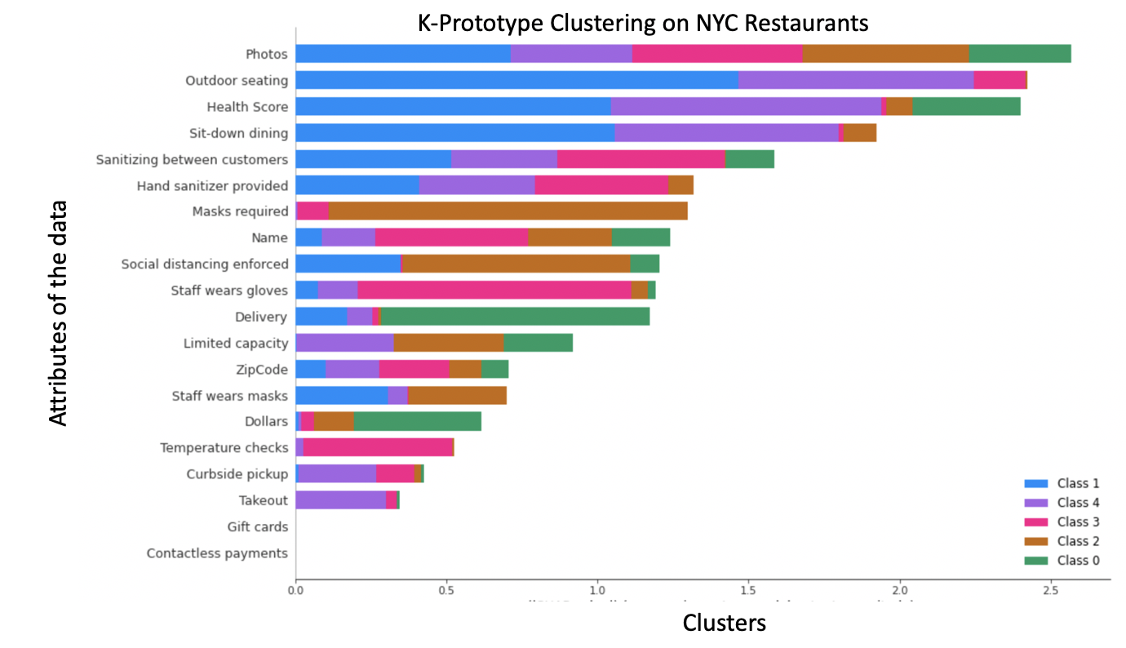
Attributes Affecting the Restaurants
STEP 4 : Cluster Data
The formatted data is now clustered into various attributes such as: Revenue, Photos, and COVID–19 Measures.
Default Clustering = Affordability

Slide 12
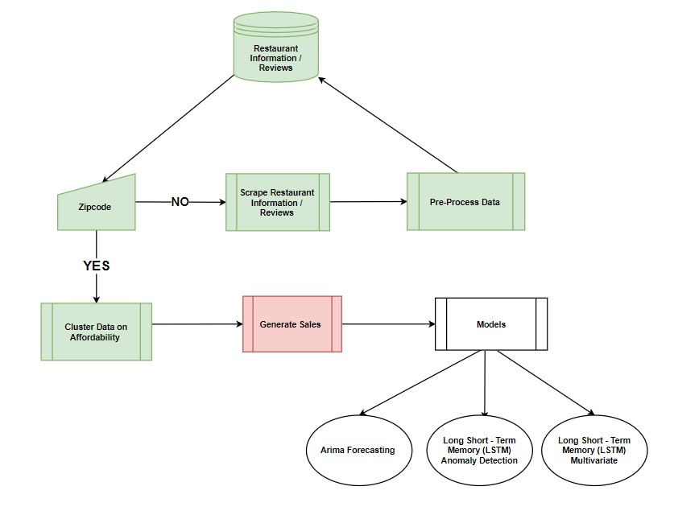
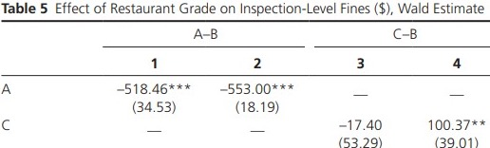
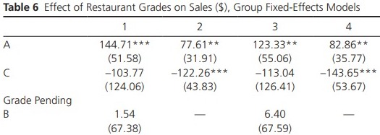
What a Difference a Grade Makes: Evidence from New York City's Restaurant Grading Policy
STEP 5 : Generate Sales
Rothbart, M.W., Schwartz, A., Calabrese, T.D., Papper, Z., Mijanovich, T., Meltzer, R., & Silver, D. (2019). What a Difference a Grade Makes: Evidence from New York City's Restaurant Grading Policy. Public Administration Review, 79, 651-665.

Slide 13
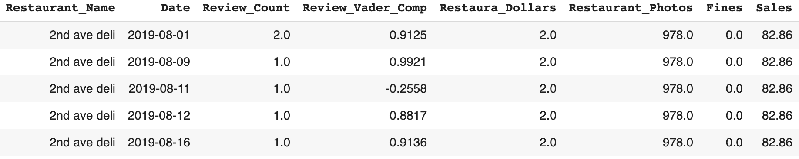
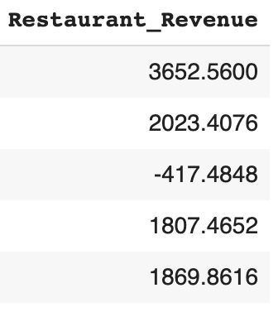
Calculated Sales
[(Review_Count) * (Review_Vader_Comp) * (Restaura_Dollars) *
(Restaurant_Photos) ] (Fines) (Sales)
STEP 5 : Generate Sales

Slide 14
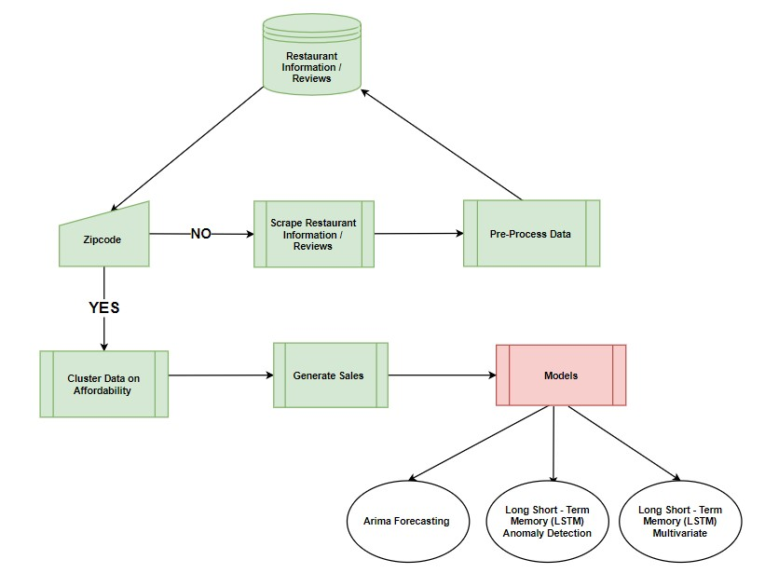
Arima Forecasting
LSTM Anomaly Detection
LSTM Multivariate
STEP 6 : Modelling

Slide 15
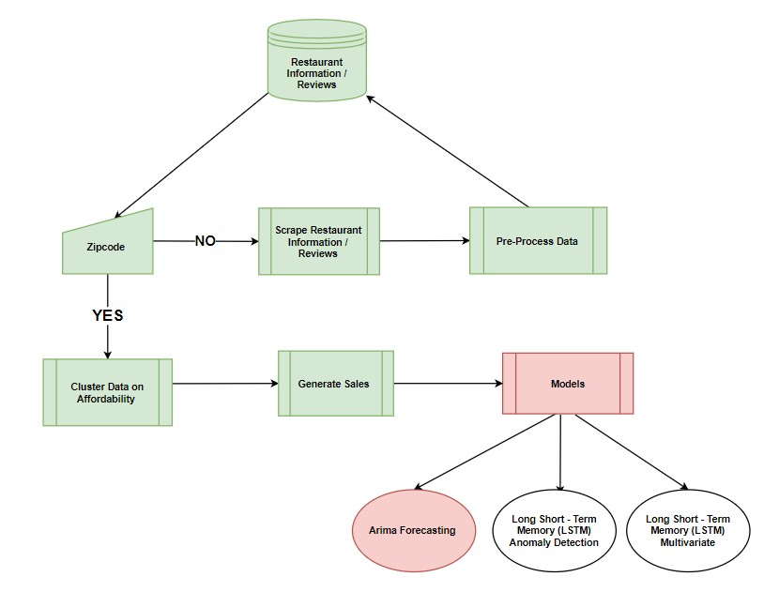
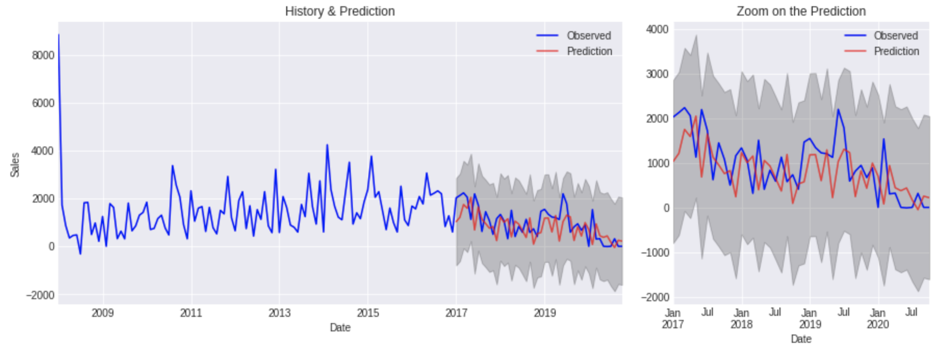
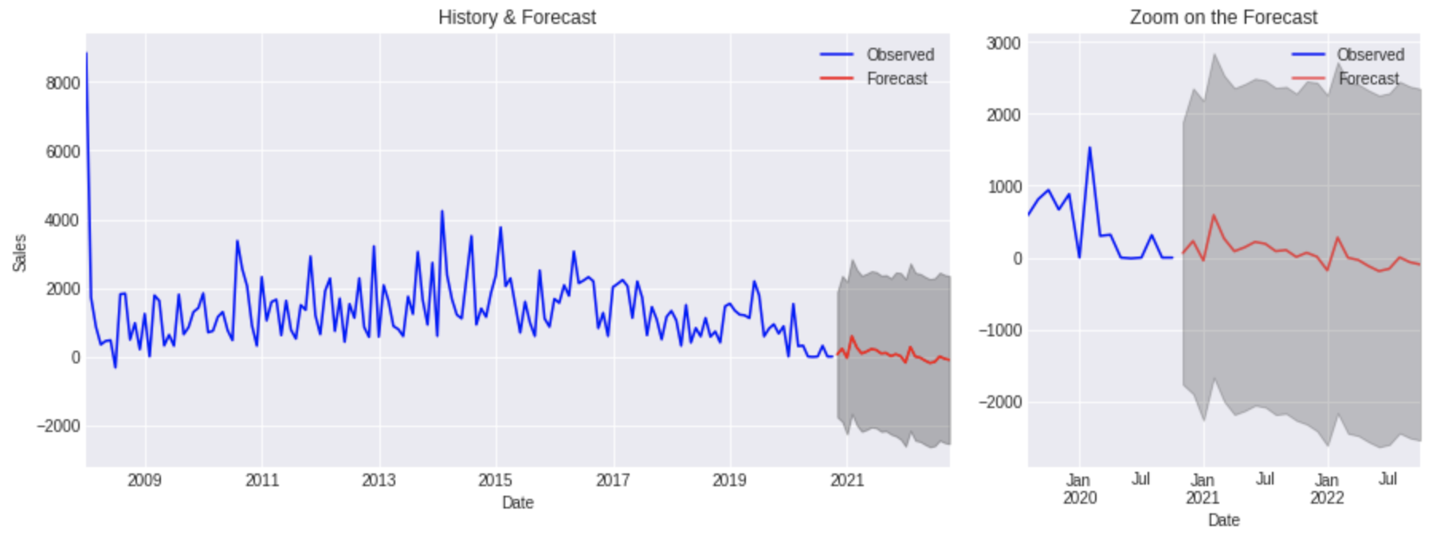
PREDICTING ON LAST 3 YEARS OF SALES
FORECASTING NEXT 2 YEARS OF SALES
Model : Arima Forecasting
Information from past values used to predict future values

Slide 16
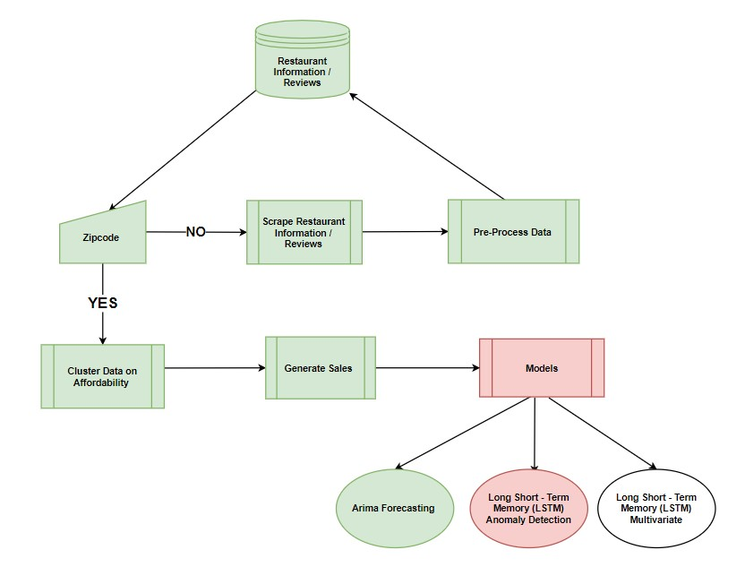
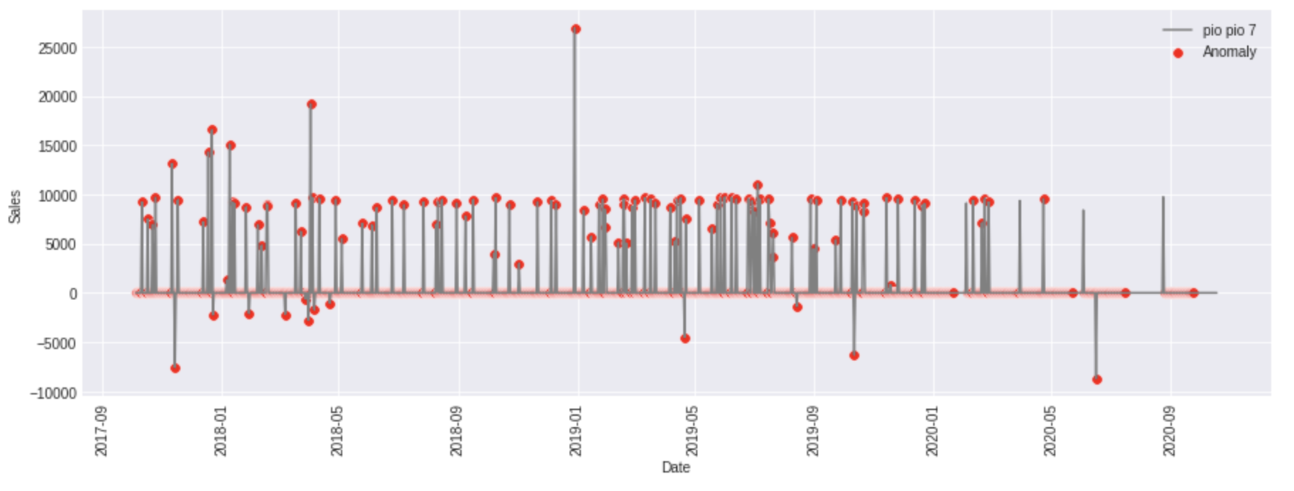
PLOTTING ANOMALY DETECTION
Model : LSTM Anomaly Detection
If a value falls away from the previous time series values, then it is an anomaly

Slide 17
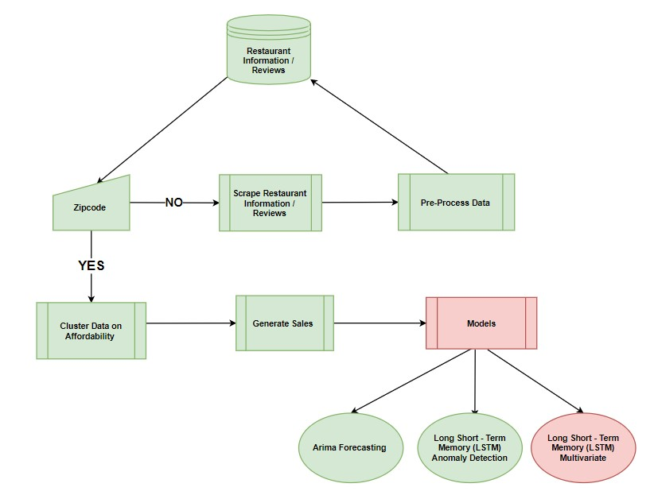
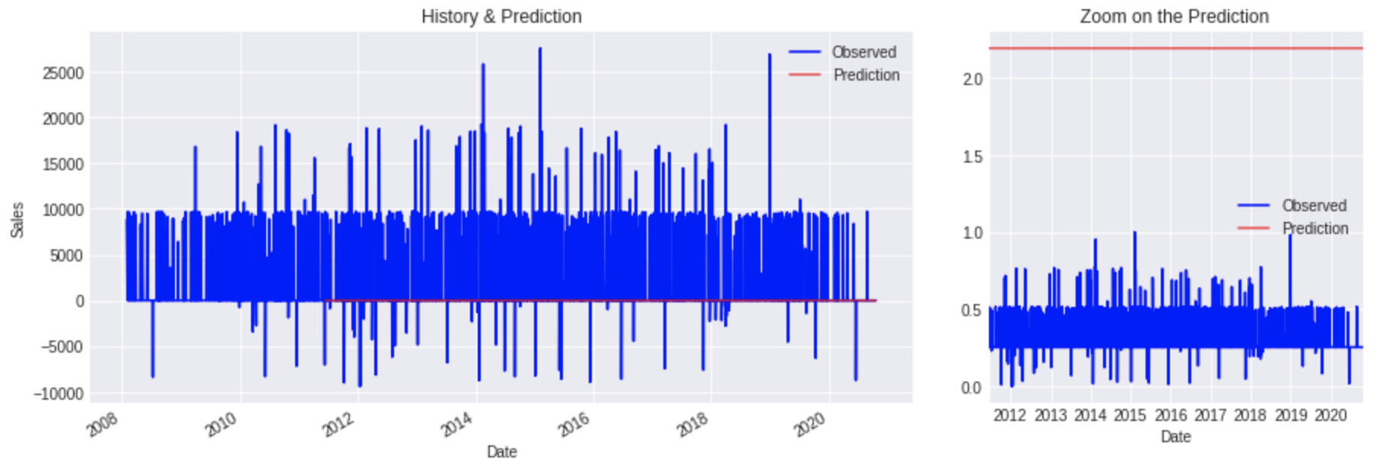
PLOT MODEL PREDICTION
Model : LSTM Multivariate
Neural Network model with multiple input variables

Slide 18
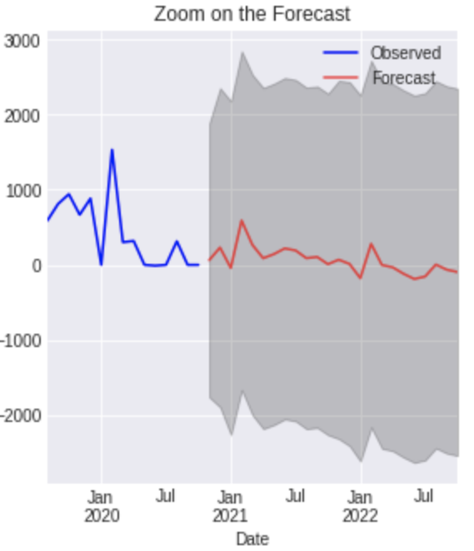
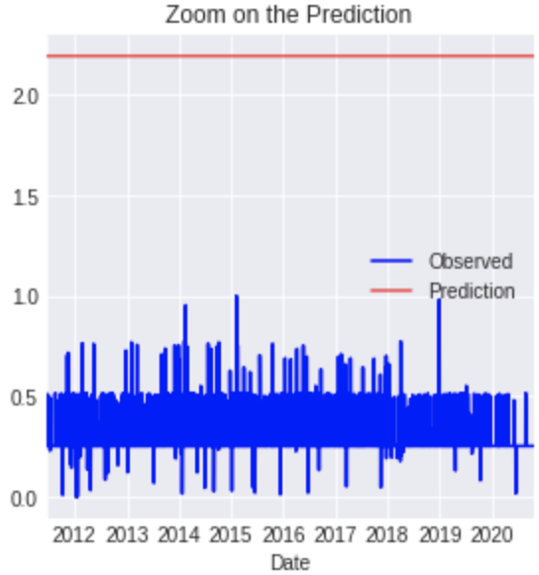
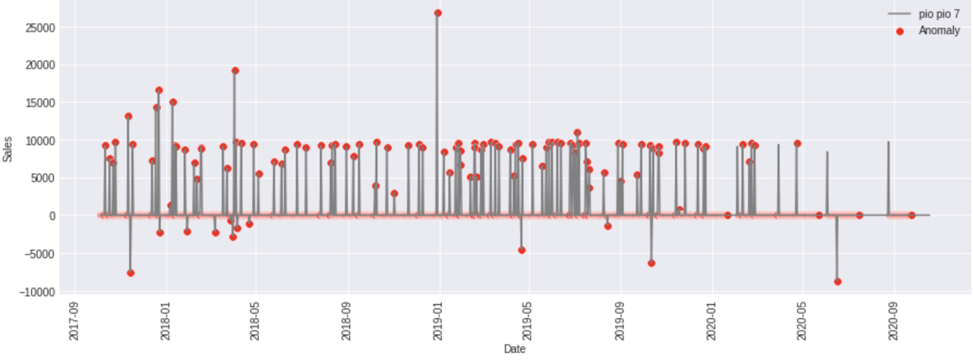
LSTM Anomaly Detection
Arima Forecasting
LSTM Multivariate
Recommendations
Based off the results from the models for the Restaurant PIO PIO 7, we can forecast that the sales are decreasing, almost leveling out to 0. There is an inconsistent sales from the anomaly detection and the multivariate model PIO PIO 7 is underperforming compared to its competition. This is the Early Warning for PIO PIO 7.

Slide 19
LIMITATIONS
FUTURE SCOPE
Data Availability
New Jersey
Revenue
Google API
Open Table API
With accurate data, we will be able to provide more significant results regarding the stability of the restaurant moving forward.
Implementation as an interface so that business owners will be able to monitor their sustainability & banks will be able to assess loan approval.

Slide 20
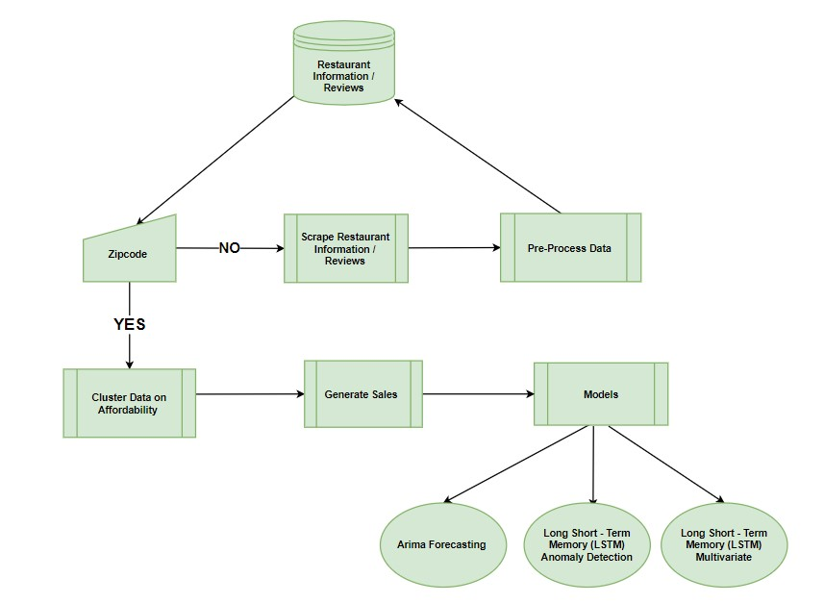
PRODUCT DEMO

Slide 21
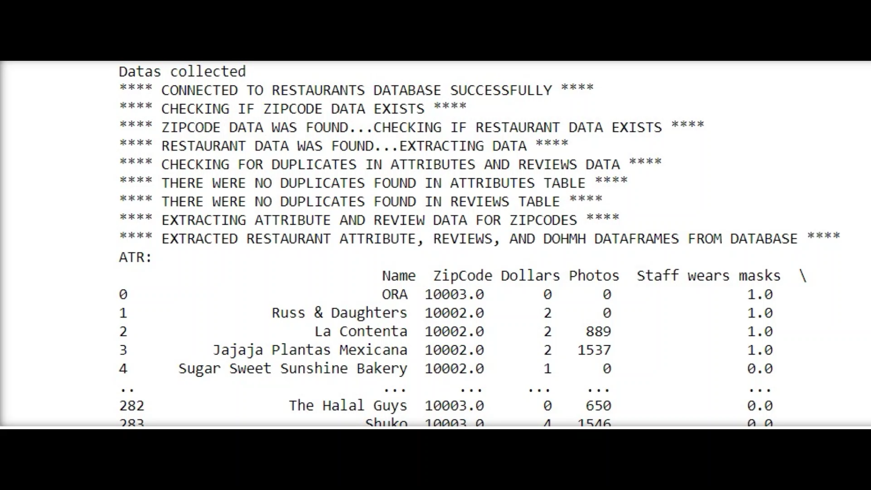

Slide 22
THANK YOU!

